Slide 1

Welcome to Year 3

Slide 2

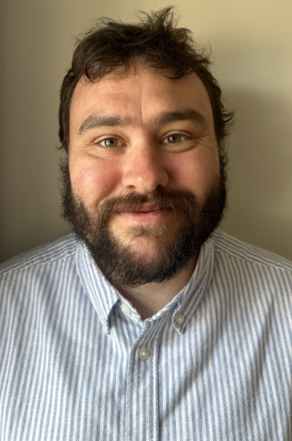
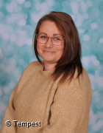
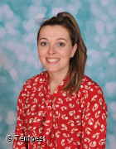

Meet the Team Cassatt Turner Mr Stemp Mrs Ralph Year 3 Teaching Assistants Mrs Worboys Miss Dyke (Interventions)
Notes:
Please use your slide from July.

Slide 3


Agenda
Behaviour Expectations
Curriculum
Homework
Spellings
PE/Uniform
Assessments
Enrichment Opportunities
Attendance Matters
SEND Support
Questions/Parent Helpers

Slide 4
Behaviour Expectations
Be safe
Be respectful
Notes:
Explain that we are reviewing our behaviour policy but we will have these core values at heart.

Slide 5
Behaviour Expectations
Being safe
Responds promptly to adult directions
Uses resources and furniture responsibly
Keeps shared spaces clean and organised
Understands and respects physical boundaries
Seeks help respectfully when needed
Follows routines (e.g. lining up, fire drills)
Understands digital footprint and online privacy
Uses strong passwords and never shares them
Knows what cyberbullying is and how to report it
Begins questioning online content reliability
Being Respectful
Uses polite greetings
Listens actively and respectfully
Collaborates, shares ideas, and takes turns
Speaks kindly, even in disagreement
Accepts responsibility and owns up to mistakes
Begins tasks without fuss and contributes in discussions
House points
Head Teacher Award
Celebration Award
Presentation Award
Notes:
We award HP and have a Headteacher Award – currently focussed on writing achievements.
1-2-3 reminders
Therapeutic approach – respond to the child. We recognise when a child is dysregulated and will use our restorative conversation mat to talk through behaviours. (Please show this in the session – every classroom should have one.)

Slide 6
Curriculum
We are in the process of developing our wider curriculum this year.
We are now using a resource called KAPOW for our Foundation subjects. For our Computing sessions we will be using Teach Computing and our PE curriculum is developed by Mr Mikelson and the use of GetSet4Education.
Our humanities topics include:
Autumn: British History and Volcanoes
Spring: Romans and Antarctica
Summer: Egyptians and Settlements

Slide 7
Homework
In Year 3, we will be sending weekly spelling practice home.
We would also like the children to use Times Tables Rockstars to ensure they have a firm knowledge of their times tables ready for the Multiplication Check in Year 4.
Finally, we would expect the children to read for a minimum of 10 minutes, at least three times a week but we would encourage more!
Notes:
Y1/2 – same as Y4 but numbots subscriptions will be purchased for the children to use at home instead.
Y3 and 4 are the same.
Y5 and 6 – reading, spellings, arithmetic and alternate comprehension and grammar activities

Slide 8
Spellings – Y3/4 Statutory List
In addition to the weekly spelling lists, we would like the children to build their knowledge of the Y3/4 statutory spelling list.
The Y1/2 HFW should also be practised if these still pose a challenge to your child.
Notes:
Y1/2 – HFW
Y3/4 – same
Y5/6 – your list

Slide 9

PE and Uniform
Children should arrive at school in their school uniform and then get changed into their PE kit at lunch time.
School logo t-shirt or in colder months plain navy or black tracksuit tops or jumpers.
White socks and plain, black trainers for outdoor PE.
Hair should be tied back, earrings taken out, nails short.
When piercing ears, please wait until the holidays as the children will not be able to take part in lessons until they can remove their earrings independently.
No Smart watches – or watches that can receive messages/access the internet to be worn at any time.
PE will be taught on Monday afternoon by Mr Mikelson

Slide 10
Assessments
In Year 3, we complete NFER assessments termly. These cover a range of multiple choice and short answer questions.
They have seen these in Year 2 and are used across the school to help them prep for future tests.
These are used to inform teacher practice and the scores are not shared with the children.

Slide 11
Enrichment Opportunities
We believe learning beyond the classroom are extremely important.
These can be visits, workshops and whole school themed days.
We are already booked to go to Flag Fen Cave where we will be looking at Stone Age Survival which will include:
Explore and experience how people lived and survived in prehistory, including traditional skills, materials and processes.
Deduct and make statements and inferences from evidence.
Understand methods of historical enquiry including experimental archaeology
Develop an understanding of the changes in Britain from the Stone Age to the Iron Age.
Develop outdoor, team working and problem-solving skills
Experience nature and how to interact with the outdoor environment
Notes:
3.3

Slide 12
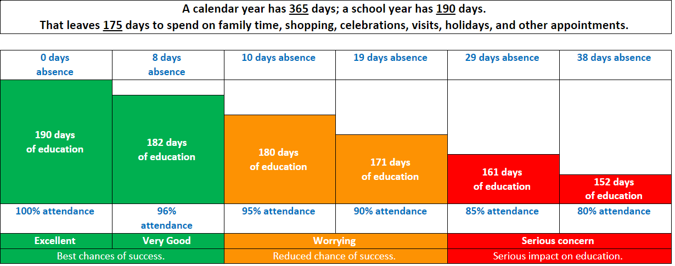
Attendance Matters
Notes:
Please reiterate the importance of attending school. Medical reasons for not being in school should be reported by 9am.
Explain that we have a term time absence form for planned absences. Holidays are generally not authorised and we must follow the government’s rule of imposing penalty notices. These have been upped to £80 per child, per parent (including step-parents). Any information for attendance and absences can be found on the website.

Slide 13
SEND Support
What do we mean by SEND?
SEND stands for Special Educational Needs and/or Disabilities.
A child has SEND if they have a learning difficulty or disability that calls for special educational provision to be made for them.
What should I do if I think my child has special educational needs and/ or a disability?
The first person to speak to is your child's class teacher. They will be able to discuss support for your child and to signpost you to any helpful resources. You can also find information about SEND at our school in our SEND Information Report on our school website.
Support from the SENDCo
If your child's class teacher thinks that it would be helpful to get specialist advice, they will discuss your child's needs with the SENDCo.
The SENDCo is Jen Gregson she can be contacted via the SEND email address: sendco@bassingbourn.cambs.sch.uk.

Slide 14

Contact
You can make an appointment to see us through the Office.
You can email us, but please do not email with something that needs attention on that day – we do not check our emails during school hours. You can find class email addresses on the website. If you receive no response after 48 hours, please contact the office.
3Ct@bassingbourn.cambs.sch.uk
3Tr@bassingbourn.cambs.sch.uk
Notes:
3.1

Slide 15
Questions
We warmly welcome parent helpers in school. Your support makes a real difference—especially in helping children build confidence and fluency in reading, which supports learning across the curriculum.
We are also grateful for volunteers who assist with school trips and swimming sessions in the Summer term.
Please note: some activities may not be able to go ahead without sufficient help.
If you're interested in volunteering, please speak to the School Office.
Thank you for your continued support.

