Slide 1

Welcome to Year 4

Slide 2

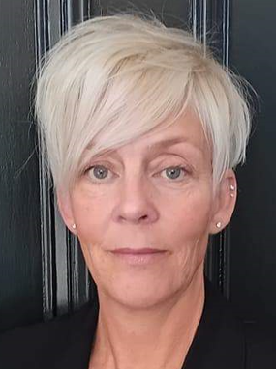

Hockney
Mrs Walsh
Monday, Tuesday, Thursday and Friday
Mrs Ager
Wednesday
Meet the Team ​
Notes:
Consistency, although PT teachers, working as a team.
FT TAs. Children familiar with Mrs Breen.

Slide 3


Agenda
Behaviour Expectations
Curriculum
Homework
Spellings
PE/Uniform
Y4 Multiplication Check
Assessments
Enrichment Opportunities
Attendance Matters
SEND Support
Questions/Parent Helpers

Slide 4
Behaviour Expectations
Restorative conversations
Involving parents
House points
Head Teacher Award
Notes:
We award HP and have a Headteacher Award – currently focussed on writing achievements.
1-2-3 reminders
Therapeutic approach – respond to the child. We recognise when a child is dysregulated and will use our restorative conversation mat to talk through behaviours. (Please show this in the session – every classroom should have one.)
The Nook – previously The Front Room. In house system of referring to the pastoral team.

Slide 5
Behaviour Expectations
Be respectful.
Be safe.
Notes:
Explain that we are reviewing our behaviour policy but we will have these core values at heart.

Slide 6

Curriculum
We are in the process of embedding our wider curriculum this year.
We are now using a resource called KAPOW for Science and all of our Foundation Subjects including our French lessons.
Our PE curriculum uses GetSet4Education.
Our humanities topics include:
Autumn: How Have Children's Lives Changed?
Spring: What Changed After the Anglo Saxon Invasion (Anglo Saxons), Rivers and the Water Cycle
Summer: The achievement of the Ancient Mayans
Notes:
Ancient Mayans was covered in Y3 but in the process of moving our curriculum around, we want to build on the children’s knowledge of this topic. We look forward to finding out what they remember!

Slide 7
Homework
In Year 4, we will be sending weekly spelling practice home.
We would also like the children to use Times Tables Rockstars to ensure they have a firm knowledge of their times tables ready for the Multiplication Check in June. This also ensures readiness for the Year 5 curriculum.
Finally, children are expected to read for a minimum of 10 minutes at least three times a week. We would highly encourage more!
Notes:
Monday 23rd – spellings weekly tests on Monday.
Reading records – collected in, 3x weekly comments from parents and children

Slide 8
Spellings – Y3/4 Statutory List
In addition to the weekly spellings, we would like the children to build their knowledge of the Y3/4 statutory spelling list.
The Y1/2 HFW should also be practised if these still pose a challenge to your child.
Dictations are a way to practise writing spelling words in a whole sentence and are used regularly within school . They are a great way to learn at home too. We encourage you to make them as silly as possible to engage your children!

Slide 9

PE and Uniform
PE days: Wednesday afternoon for Hockney
Children should arrive at school in their school uniform and then get changed into their PE kit at lunch time.
School logo t-shirt or in colder months plain navy or black tracksuit tops or jumpers.
White socks and plain, black trainers for outdoor PE.
Hair should be tied back, earrings taken out, nails short.
When piercing ears, please wait until the holidays as the children will not be able to take part in lessons until they can remove their earrings independently.
No smart watches – or watches that can receive messages/access the internet to be worn at any time.

Slide 10
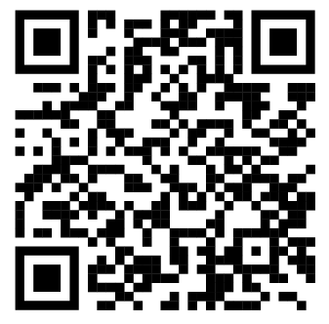
Multiplication Check
The children will sit a quick-fire, online assessment of their times tables knowledge in the first couple of weeks in June. We will be practising weekly and will share more information nearer the time.
Should you wish to practise at home, please do use your child’s login for Times Tables Rockstars.
Notes:
Teach times tables

Slide 11
Assessments
In Year 4, we complete NFER assessments termly. These cover a range of multiple choice and short answer questions.
These are used to inform teacher practice and the scores are not shared with the children.

Slide 12

Enrichment Opportunities
We believe learning beyond the classroom is extremely important. These includes visits, workshops and whole-school themed days.
We are in the process of finalising these for the year.
Notes:
3.3

Slide 13
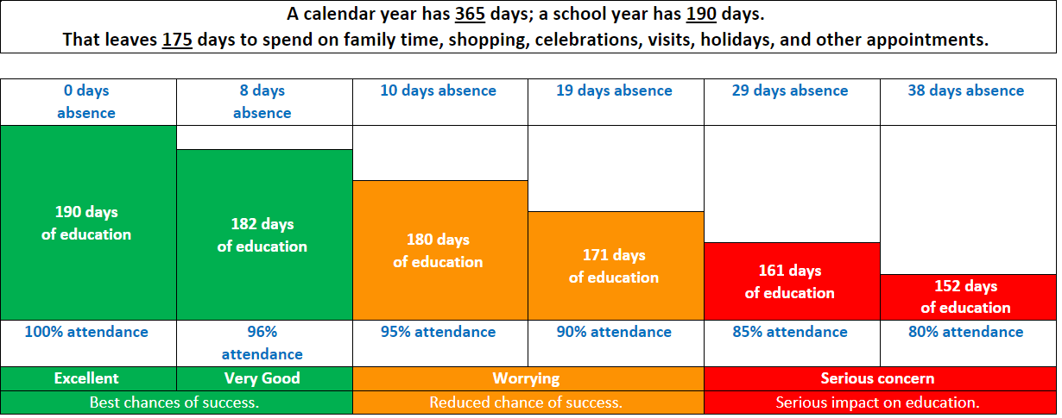
Attendance Matters
Notes:
Please reiterate the importance of attending school. Medical reasons for not being in school should be reported by 9am.
Explain that we have a term time absence form for planned absences. Holidays are generally not authorised and we must follow the government’s rule of imposing penalty notices. These have been upped to £80 per child, per parent (including step-parents). Any information for attendance and absences can be found on the website.

Slide 14
SEND Support
What do we mean by SEND?
SEND stands for Special Educational Needs and/or Disabilities.
A child has SEND if they have a learning difficulty or disability that calls for special educational provision to be made for them.
What should I do if I think my child has special educational needs and/ or a disability?
The first person to speak to is your child's class teacher. They will be able to discuss support for your child and to signpost you to any helpful resources. You can also find information about SEND at our school in our SEND Information Report on our school website.
Support from the SENDCo
If your child's class teacher thinks that it would be helpful to get specialist advice, they will discuss your child's needs with the SENDCo.
The Interim SENDCo is Jen Gregson, standing in for Mrs Hannah Paradis during her maternity leave. Miss Gregson can be contacted via the SEND email address: sendco@bassingbourn.cambs.sch.uk.

Slide 15

Contact
You can make an appointment to see us through the school office.
You can email us, but please do not email with something that needs attention on that day . We do not check our emails during school hours. You can find class email addresses on the website. If you receive no response after 48 hours, please contact the office.
4Ln@bassingbourn.cambs.sch.uk
4Hy@bassingbourn.cambs.sch.uk
Notes:
3.1

Slide 16
Questions
We would really welcome parent helpers in school. If you would like to volunteer to help out in Year 4 then please talk to the office.

