Slide 1
Our core purpose and values at BCPS.

Slide 2
Respect
To begin, our whole school focus will be to ‘be respectful to ourselves, others and the planet.’
We have begun to consider what we expect from our children and what our current targets are. We will gather pupil voice by speaking to the children about what they feel our priorities are (as well as staff). These will inform the ‘steps/actions’ our school will take to implement the core value in the centre.
The phrases will have corresponding icons and will be displayed in each classroom and around the school to be referred to by all members of staff to ensure consistency. These agreed phrases will become part of the children’s (and staffs’) regular vocabulary.
The Widgits (icons) help KS1 children, children who speak English as a second language, dyslexia etc, as they can be used to support communication for routines, behaviour and new vocabulary.
?
?
?
?
?

Slide 3
Behaviour at home

Slide 4
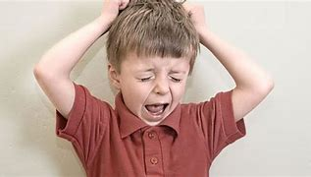
What do challenging behaviours look like?
Deliberate aggression (e.g. hitting, kicking, biting)
Self-injurious behaviour (e.g. head banging, biting self, hitting self)
Shouting/swearing
Throwing items/breaking things
Defiance: ignoring your requests like refusing to go to school or sleep on time
Fussiness: refusal to eat certain healthy foods or wear certain clothes
Displaying excessive anger through shouting or breaking things when they don’t get their way
Becoming quick to get frustrated
Harmful impulsiveness like snatching things out of other people's hands or pushing people to get in front of the queue
Having frequent tantrums or tantrums that last for longer than typical

Slide 6
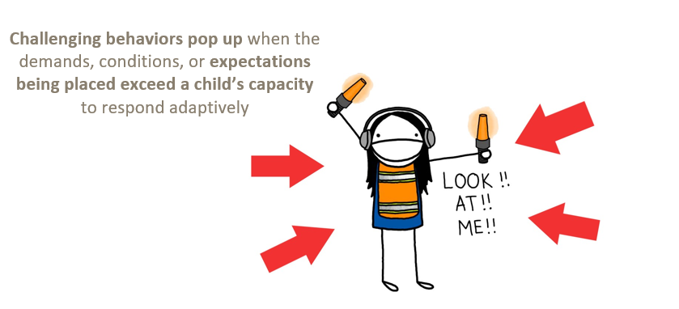

Slide 7
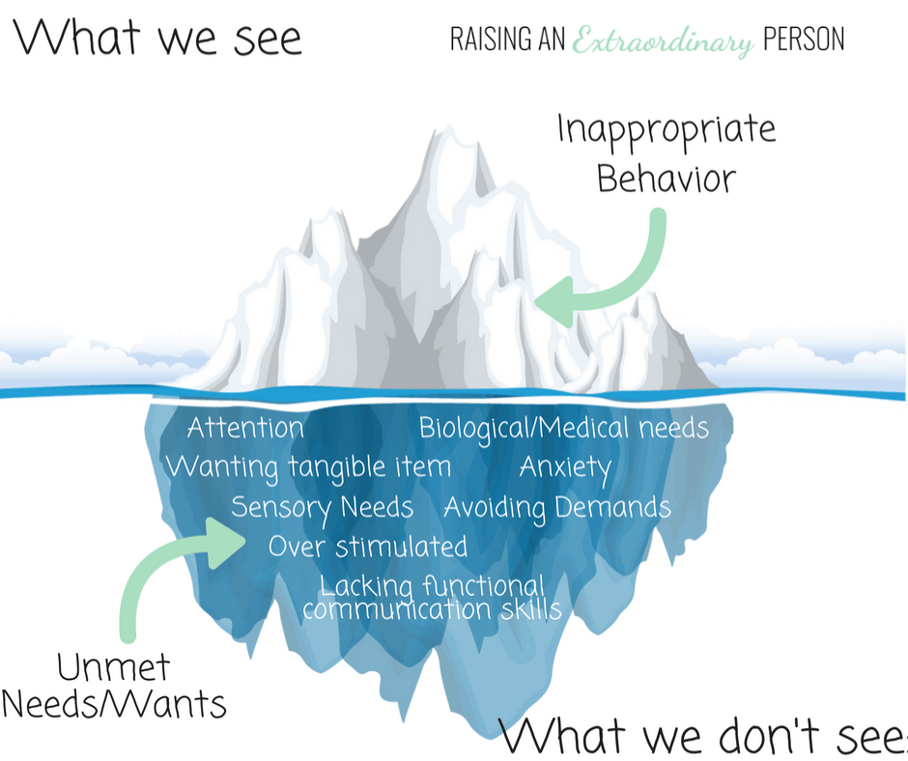

Slide 8
Let’s look more closely at these reasons for challenging behaviours….
Attention
Escape/avoidance
Access to tangibles
Sensory

Slide 12
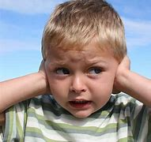
Sensory
Does my child struggle to regulate when it comes to certain sensory stimulations?
Loud noise?
Lots of light?
Lots of demands?
Busy places?
Textures?
Certain sounds?
Certain clothes?
Are they overwhelmed when it comes to any these things
Does your child cover their ears? Cover their eyes?

Slide 13
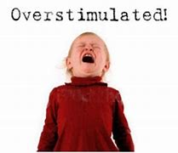
Over stimulated – one or more of 5 senses is overloaded
If your child is overstimulated, you may experience the following behaviours:
Looking very cranky or tired
Irritable
Restlessness
Discomfort
Anxiety
Cry more than usual
Not making eye contact with you

Slide 14
Why do these behaviours keep happening?
We can sometimes reinforce these challenging behaviours (unknowingly!)
Providing physical or verbal attention following an undesired behaviour
Saying “No” but then eventually giving in
Continuing to engage in debates
Changing plans after a problematic behaviour occurs
Using bribery (promising something good if a problem behaviour stops)

Slide 15
What is your child's behaviour telling you? What are they communicating?
All behaviour is communication
What is their unmet need? Remember the iceberg!!!
Children need to feel listened to
Validate their emotions/feelings
Listening empowers them

Slide 17
Strategies….
Build relationships
Listening to your child- What are they communicating?
Positive reinforcement
Rules/boundaries
Routine
Consistency- IS KEY!

Slide 19
Positive reinforcement
Lots of positive praise
‘Catch’ them being good and praise!
Rewards and celebrations
Immediate praise- and specific
Tangible rewards
Keep them motivated

Slide 20
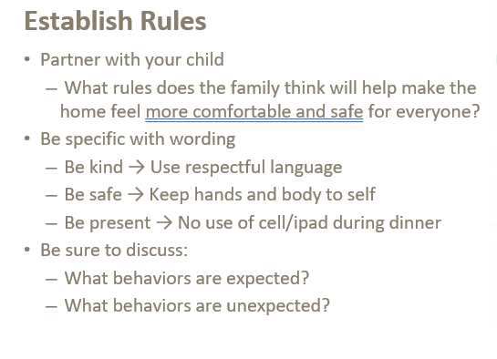

Slide 22
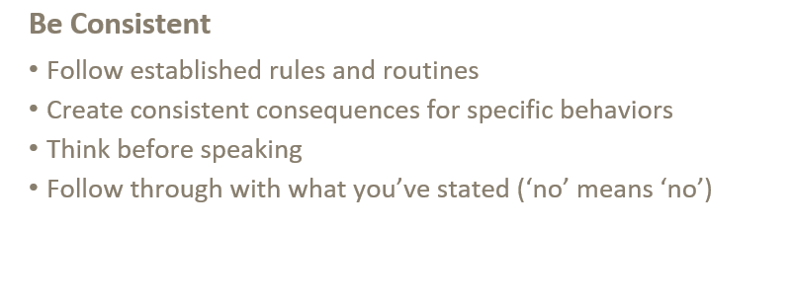

Slide 23
What if all of this doesn’t work?

Slide 24
Useful websites…..
Child Mind Institute
Positive parenting | NSPCC Learning
Challenging Behaviour Foundation
YoungMinds
Center for Parent Information and Resources (parentcenterhub.org)

Slide 25
